Slide 1
CONCEPT MAP- CPDIC CHAPTER 7 feedback controllers

Slide 2
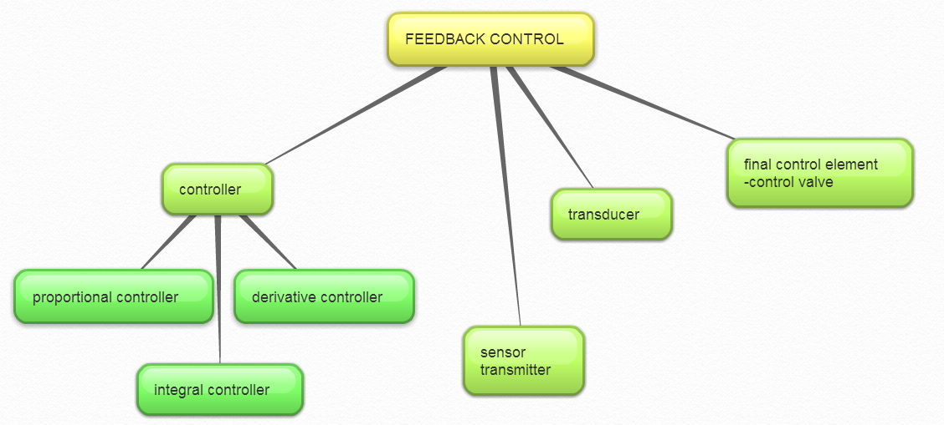

Slide 7
CONCEPT MAP-CPDIC CHAPTER 8 -dynamic behavior of closed-loop control system -closed-loop responses of simple control system

Slide 9
Standard block diagram

Slide 10
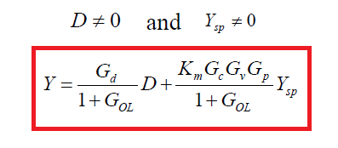

Slide 11
General expression for feedback control system

Slide 12
Concept map- cpdic chapter 9 stability of closed-loop control systems

