Slide 1
CONCEPT MAP CPDIC

Slide 2
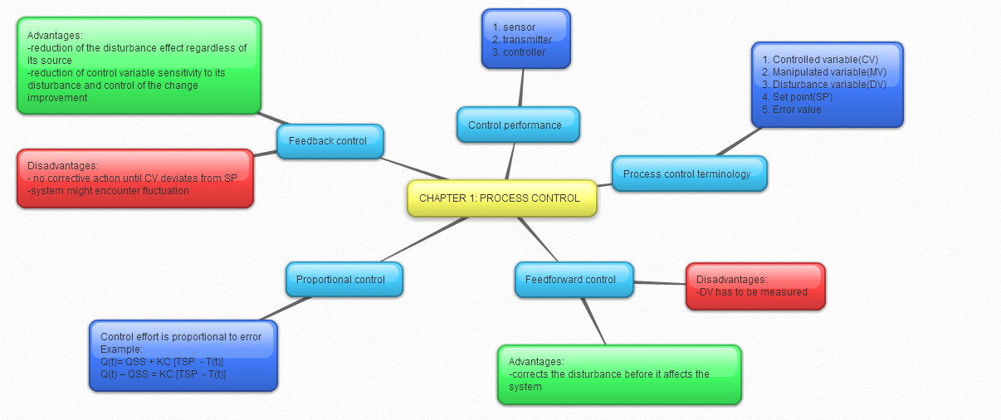

Slide 3
Calculations performed by controller
T (t) / m (load)
Comparator
T_{SP}
V_{SP}
e (t)
Controller
P (t)
Heater
Q (t)
MixingTank
Thermocouple Calibration
+
T (t)
[volts]
[volts]
[volts]
[watts]
-
V (t)
Thermocouple (Sensor) and Transmitter
[volts]

Slide 4
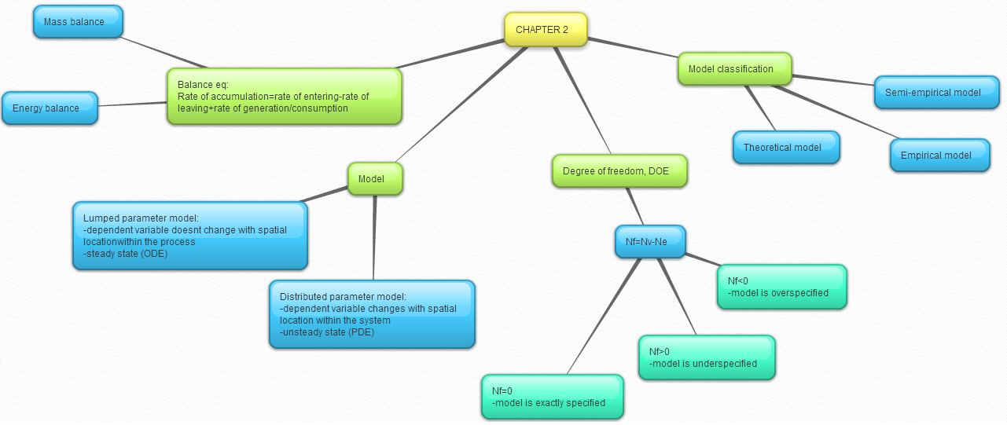

Slide 6
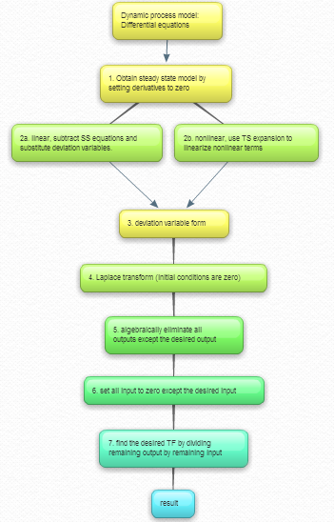

Slide 7
